Slide 1
TOURISM MANAGEMENT SYSTEM
Under the Guidance of
Trainer Mrs. Indrakka Mali
Submitted by
Ms. Monika S.P
Ms. Nivetha S
Ms. Pavithra G
Ms. Poonam P.H
Ms. VishnuPriya D

Slide 2
Content
Introduction
Objectives
System View
Modules Description
Requirement
Annotation
Screenshots
Database Table Design
Conclusion

Slide 3
Introduction
The project “Tourist Management System” is developed using spring boot framework, which mainly focuses on basic operations of visitors information system.
Like Inserting, Deleting, Updating and getting all records of visitors introduction.

Slide 4
Objectives
It provides “better and efficient” service.
Faster way to get information about the visitors.
Provide facility for proper AdminAccomodation and Package details.
All details will be available on a click.

Slide 5
System View
The Tourism management system will be automated the traditional system.
There is no need to use paper and pen.
Checking a visitor details is very easy.
Adding new visitor record also very easy to insert.
Deleting and Updating a record of a particular visitor details is simple.

Slide 6
Modules Description
1. Admin Module
We can enter the Name and Password for Admin.
We can give visitor personal details in the Admin module.
We can get the visitors details and delete by record by using visitors id and name

Slide 7
2. Visitor Module
In the visitor module the visitors can perform:
Fetch all visitor’s records.
Fetch visitor record by visitor Id.
Fetch visitor record by visitor EmailId.
Fetch visitor record by visitor Name.
Fetch visitor record by Address and Mobile Number.
One visitor can eligible to apply for many tourist place.

Slide 8
Requirement
Software Requirement
Database: MySQL .
API- Spring Data JPA, spring web, spring security.
Tools: Postman, IDE-Spring Tool Suit4 .
Coding language: Java 1.8.

Slide 9
Hardware Requirement
RAM: 8GB
Processor: 64bit OS
Memory: 700MB
Disk Space: 1TB

Slide 10
Annotation
1. @Entity : It specifies that the class is an entity and is mapped to a database table.
2. @Table : It specifies the name of the database table to be use for mapping.
3. @Id : It specific variable primary key of the database.
4. @NotNull : Content is not null on the table.
5. @NotBlank : Used to context is not empty on the table.
6. @Length : Used to specify the length of content placed on the table.
7. @Service : We mark beans with @Service to indicate that they're holding the business logic.

Slide 11
8.@Repository : To catch persistence-specific exceptions and re-throw them as one of spring’s unified unchecked exceptions.
9.@Autowired : The spring framework enables automatic dependency injection.
10.@RestController : It is used at the class level and allows the class to handle the requests made by the client.
11.@GetMapping : Is a specialized version of @RequestMapping annotation that acts as a shortcut for @RequestMapping(method = RequestMethod.GET).
12.@PostMapping : The methods in the @Controller annotated classes handle the HTTP POST requests matched with given URI expression.
13.@DeleteMapping : It maps the HTTP DELETE requests on the specific handler method.

Slide 12
13.@PutMapping: It maps the HTTP PUT requests on the specific handler method. 14.@GeneratedValue : Marking a field with the annotation specifies that a value will be automatically generated for the field. 15.@SequenceGenerator : The defines a primary key generator that may be referenced by name when a generator element is specified for the GeneratedValue annotation. 16. @JoinColumn : Used to combine the foreign key column on this table. 17.@OneToMany : A one-to-many relationship between two entities is defined by using the @OneToMany annotation in Spring Data JPA.

Slide 13
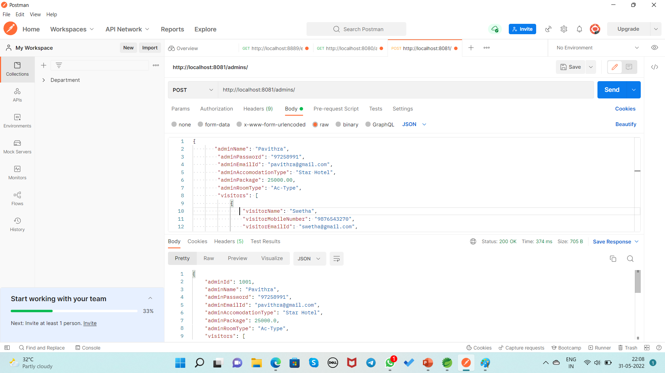
Screenshot Inserting the Admin and Visitor By Using POST Method URL:http://localhost:8081/admins/

Slide 14
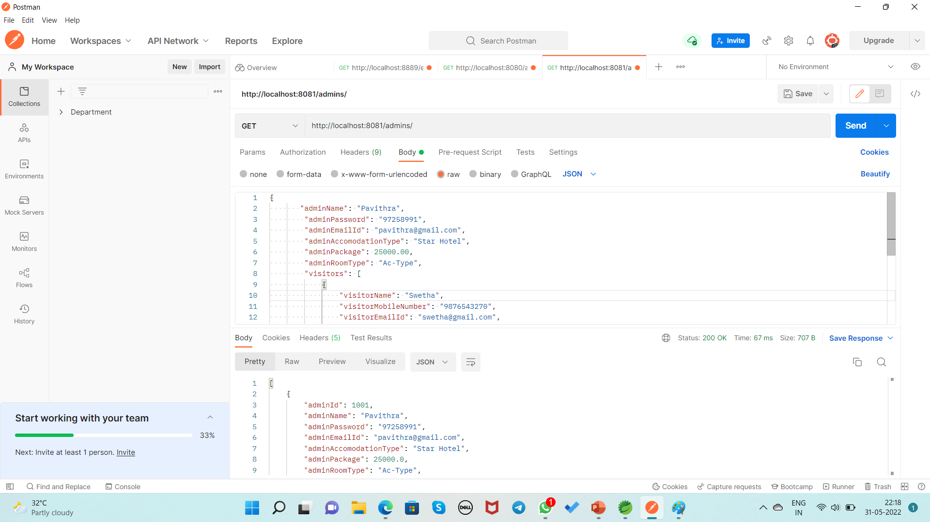
Display the all record of Admin By Using GET Method URL:http://localhost:8081/admins/

Slide 15
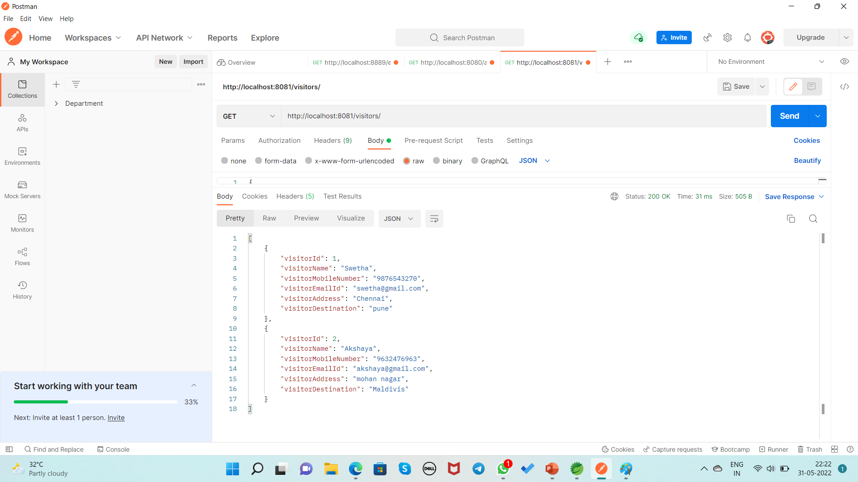
Display the all record of Visitor By Using GET Method URL:http://localhost:8081/visitors/

Slide 16
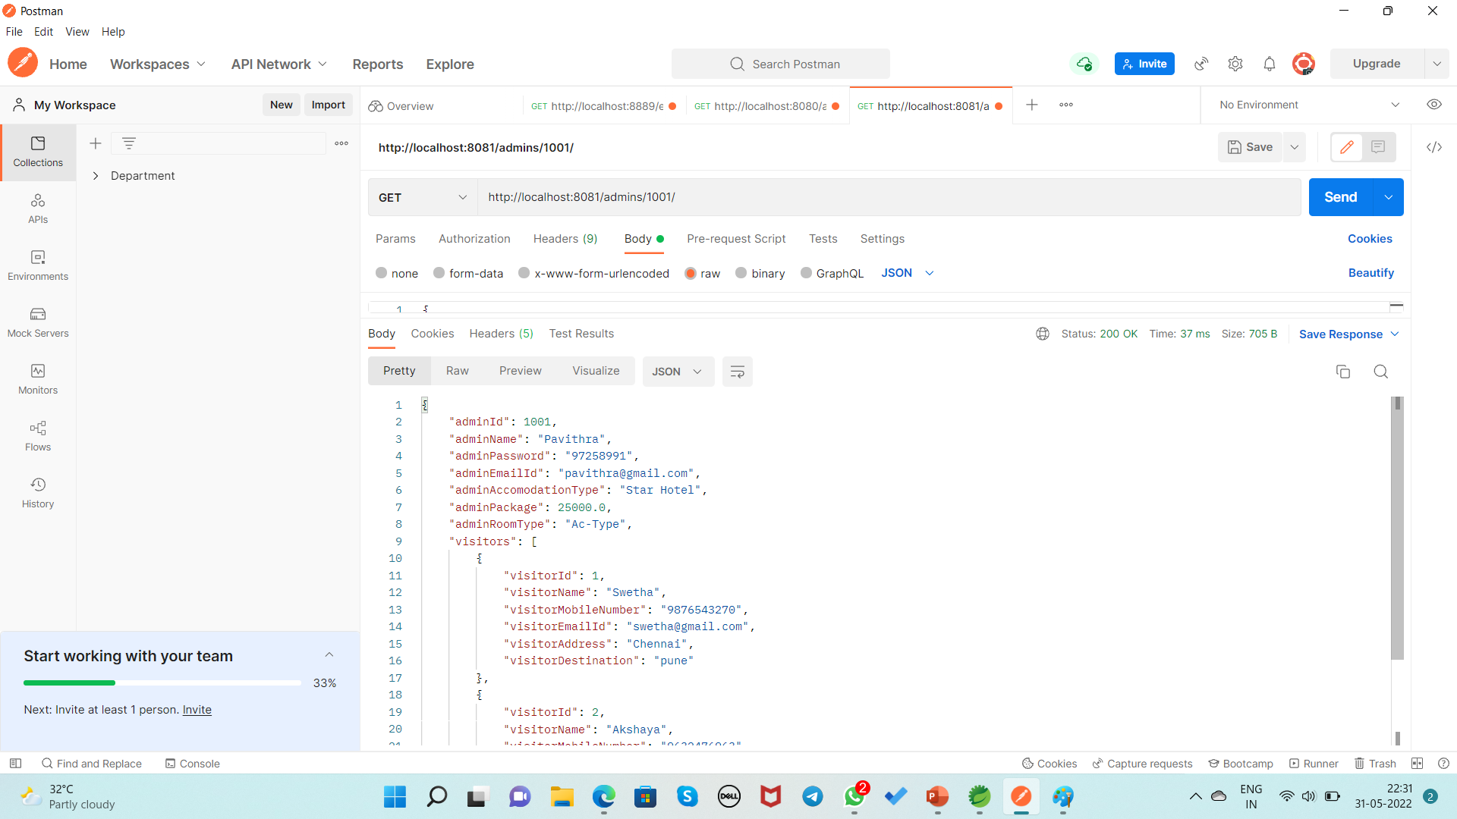
Display the record of Admin based on Id By Using GET Method URL:http://localhost:8081/admins/1001/

Slide 17
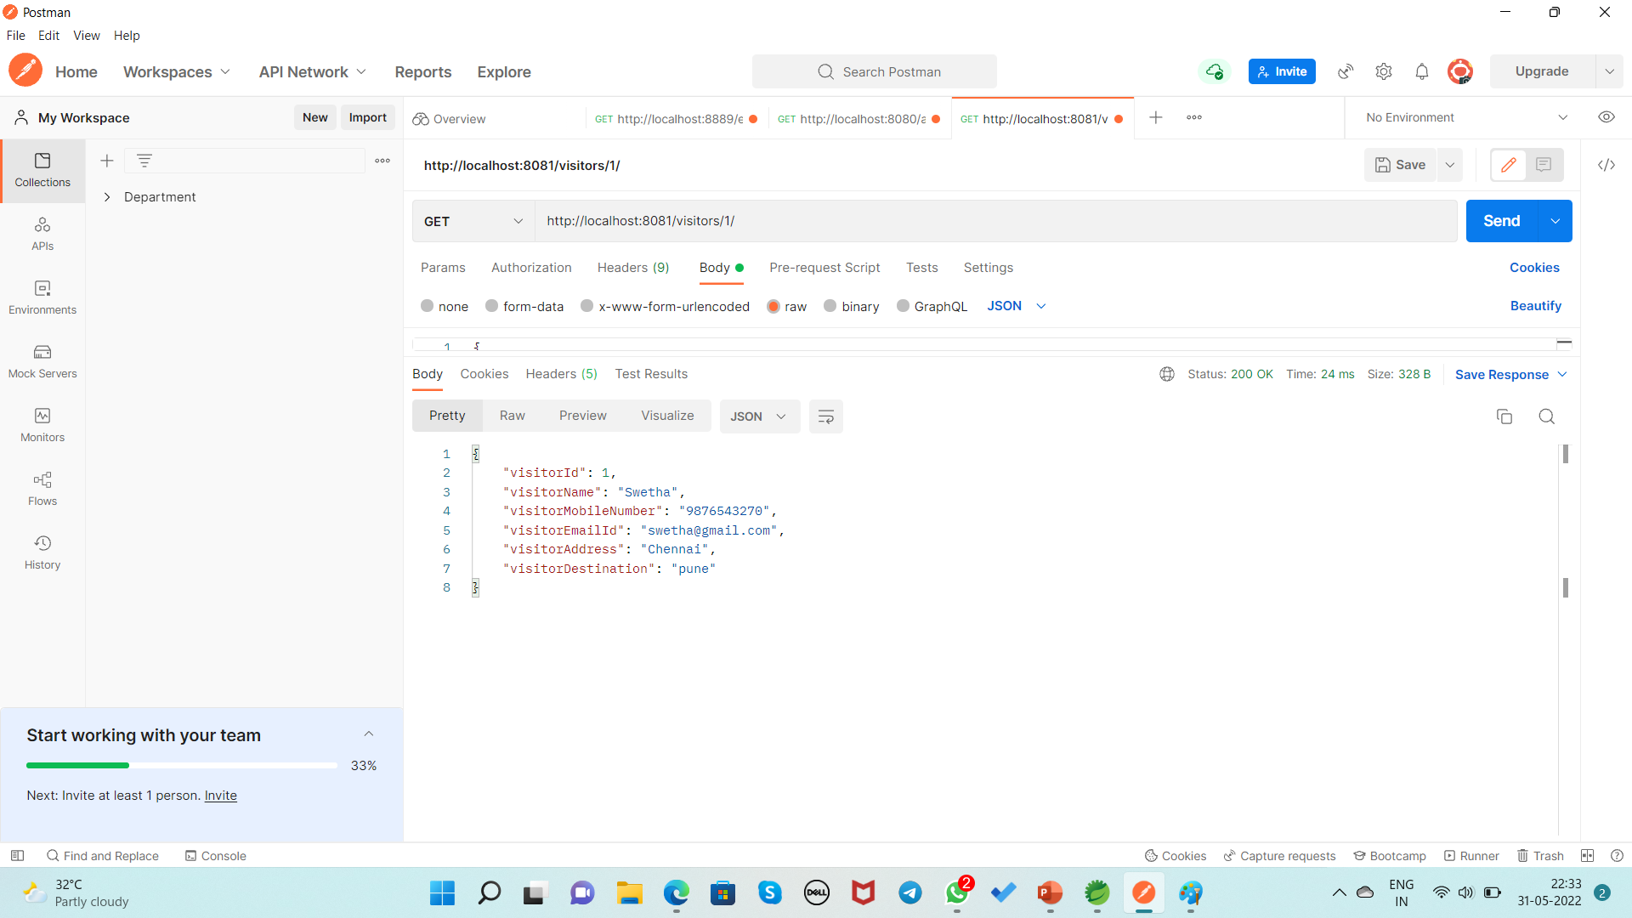
Display the record of Visitor based on Id By Using GET Method URL:http://localhost:8081/visitors/1/

Slide 18
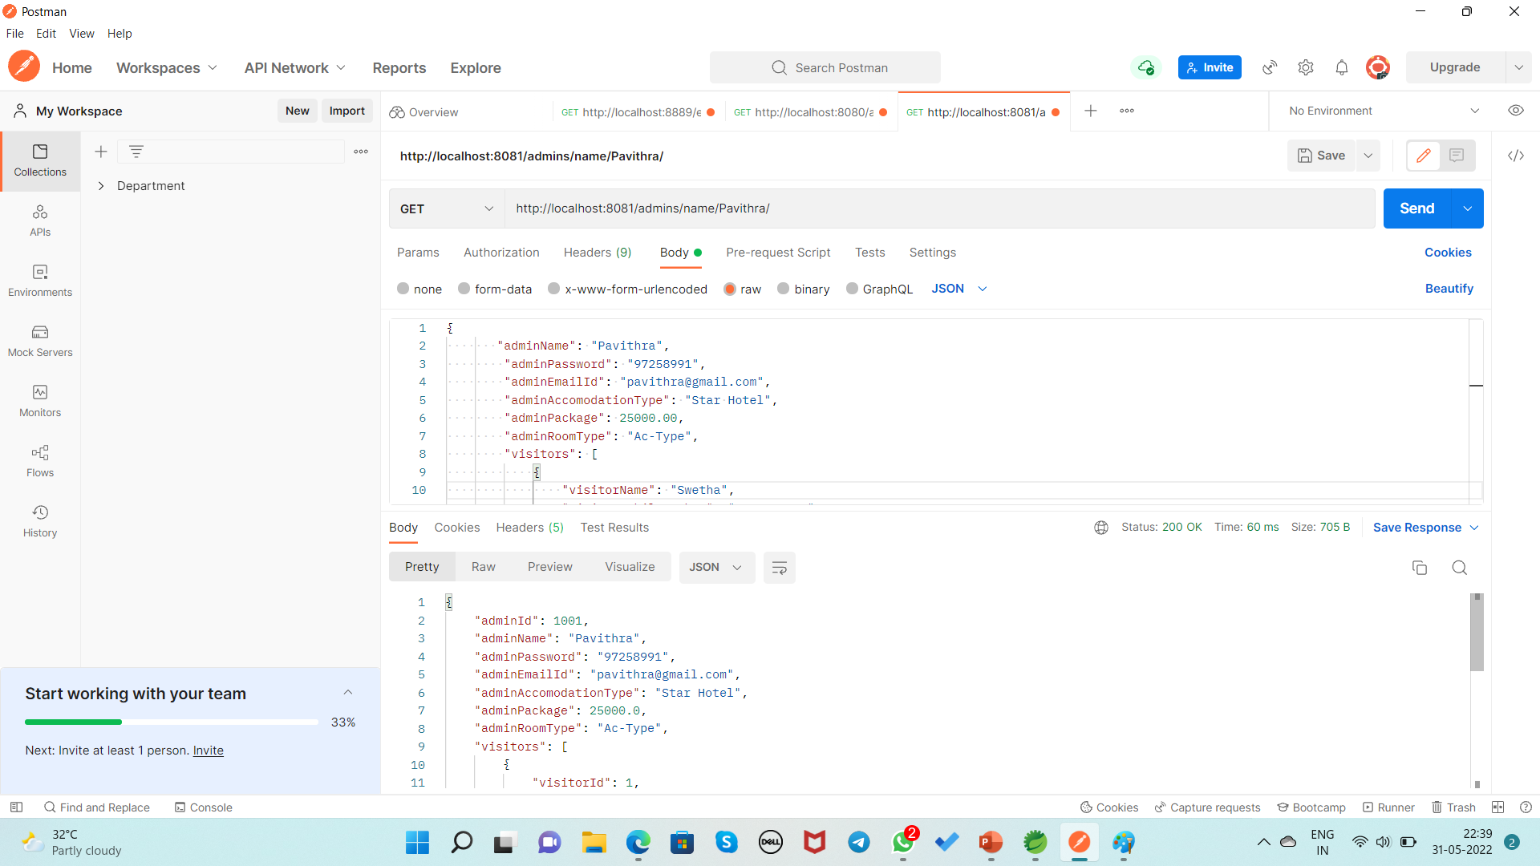
Display the record of Admin based on Name By Using GET Method URL:http://localhost:8081/admins/name/Pavithra/

Slide 19
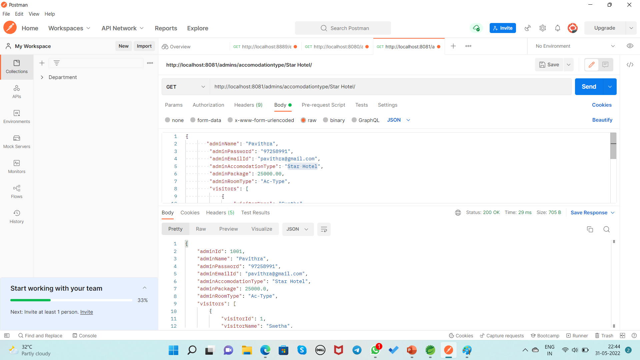
Display the record of Admin based on AccomodationType By Using GET Method URL:http://localhost:8081/admins/accomodationtype/Star Hotel/

Slide 20

Display the record of Admin based on RoomType By Using GET Method URL:http://localhost:8081/admins/room type/Ac-Type/

Slide 21
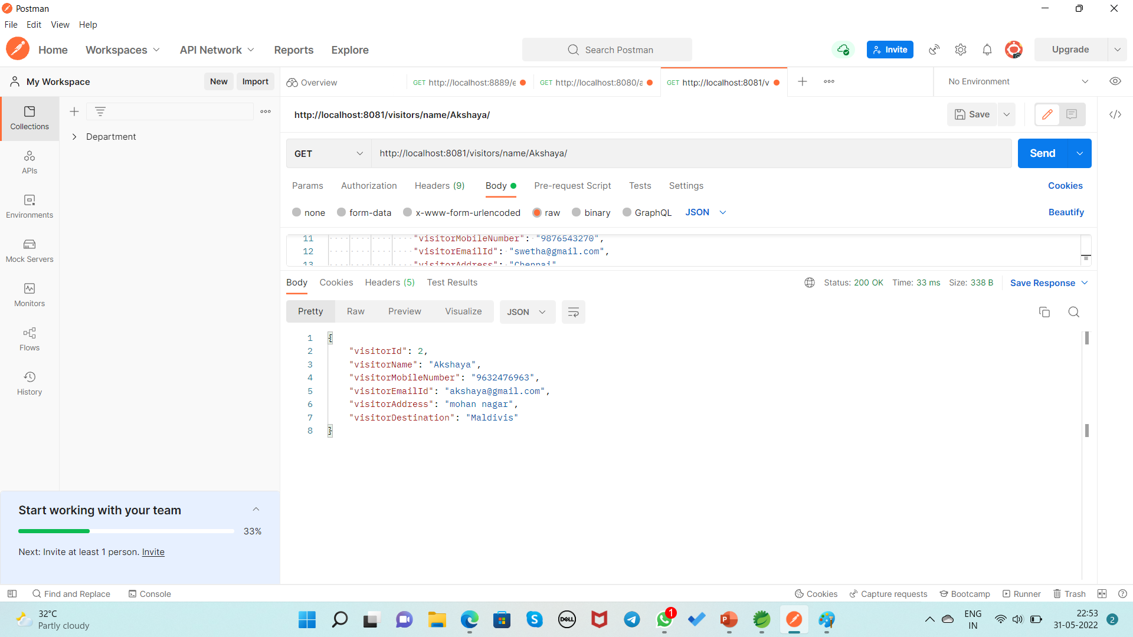
Display the record of Visitor based on Name By Using GET Method URL:http://localhost:8081/visitors/name/Akshaya/

Slide 22
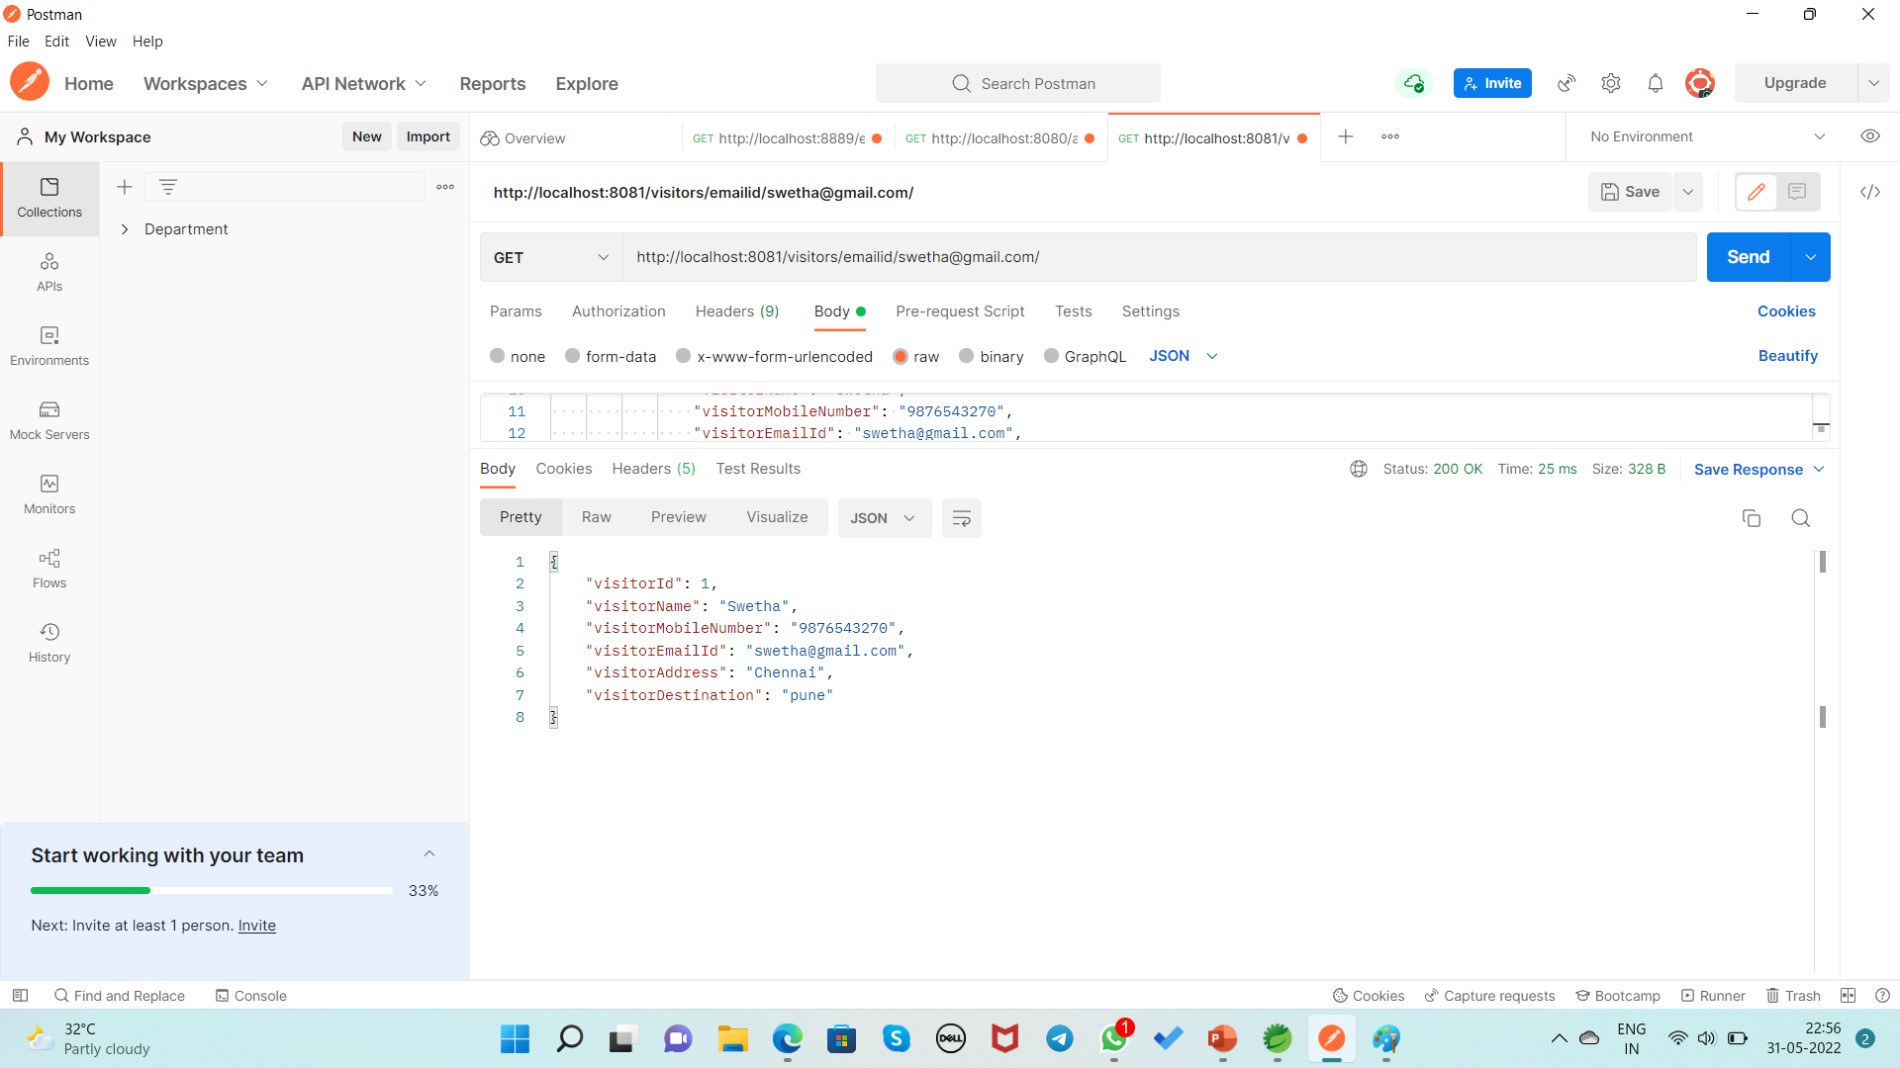
Display the record of Visitor based on EmailId By Using GET Method URL:http://localhost:8081/visitors/emailid/swetha@gmail.com/

Slide 23
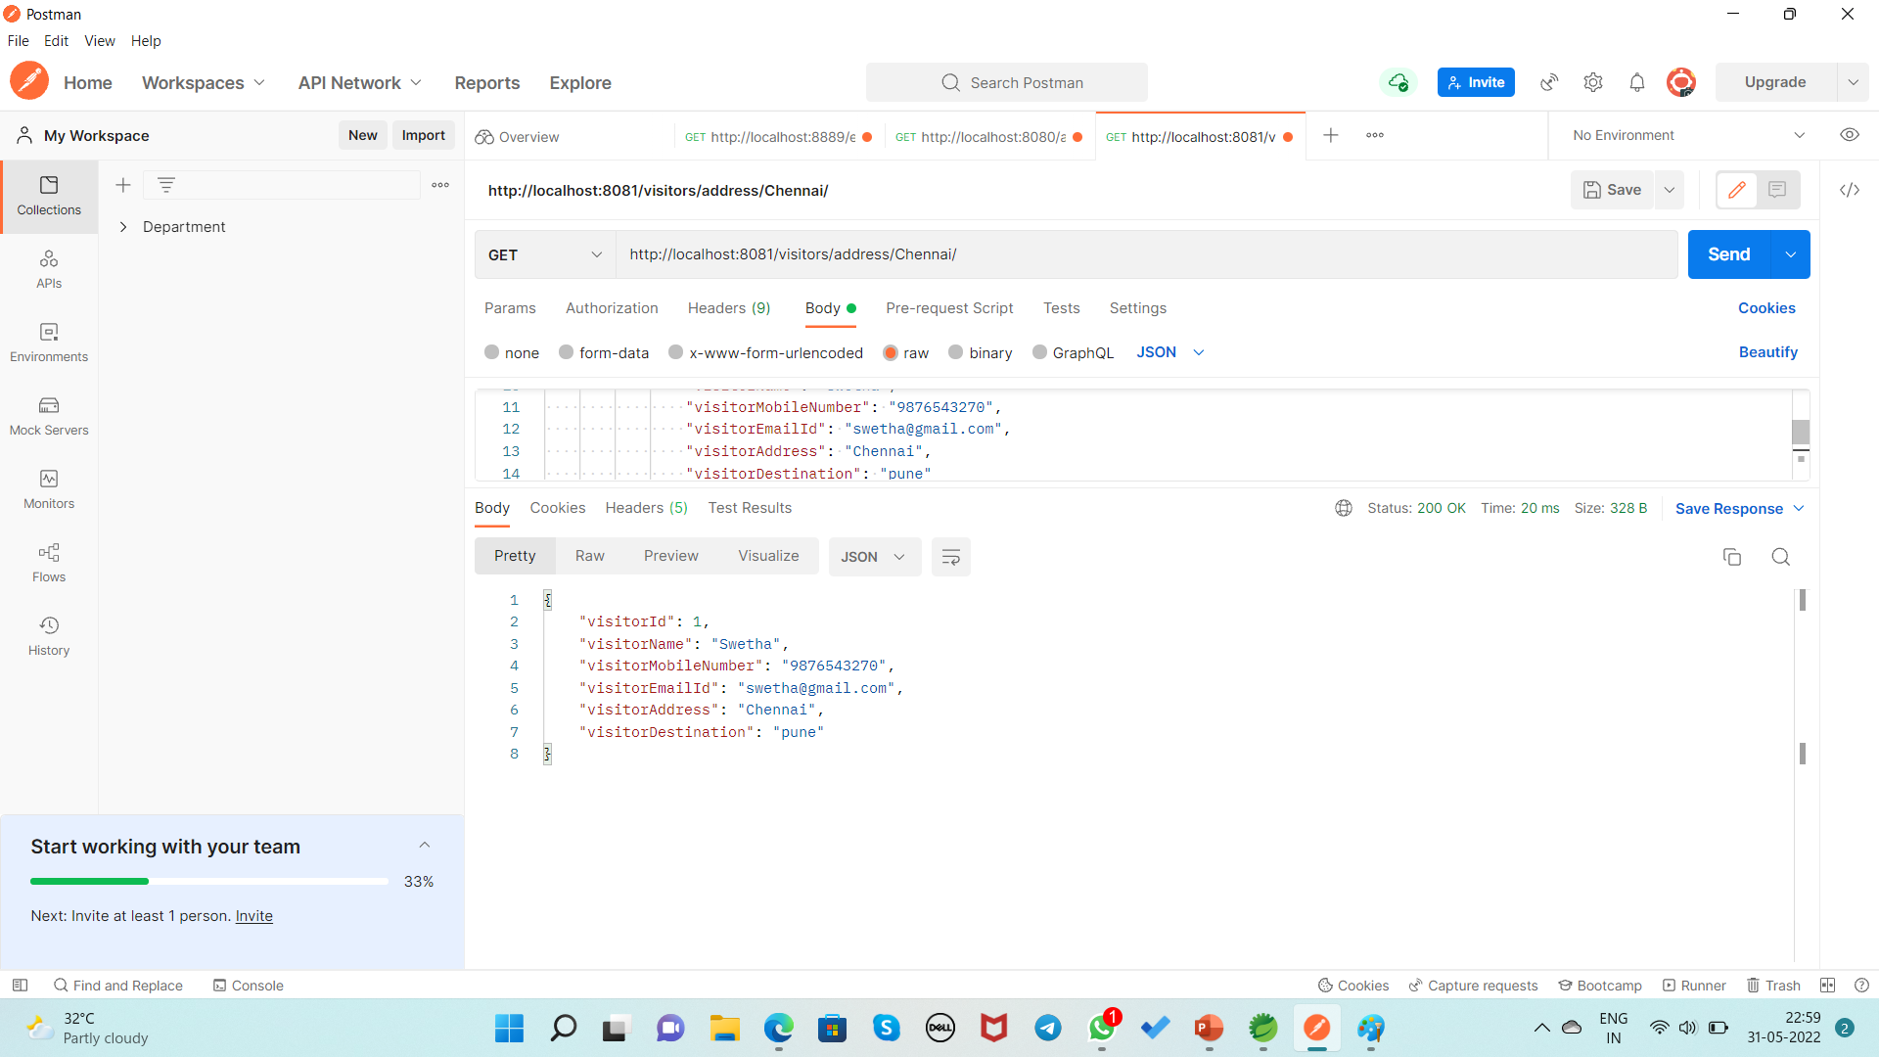
Display the record of Visitor based on Address By Using GET Method URL:http://localhost:8081/visitors/address/Chennai/

Slide 24
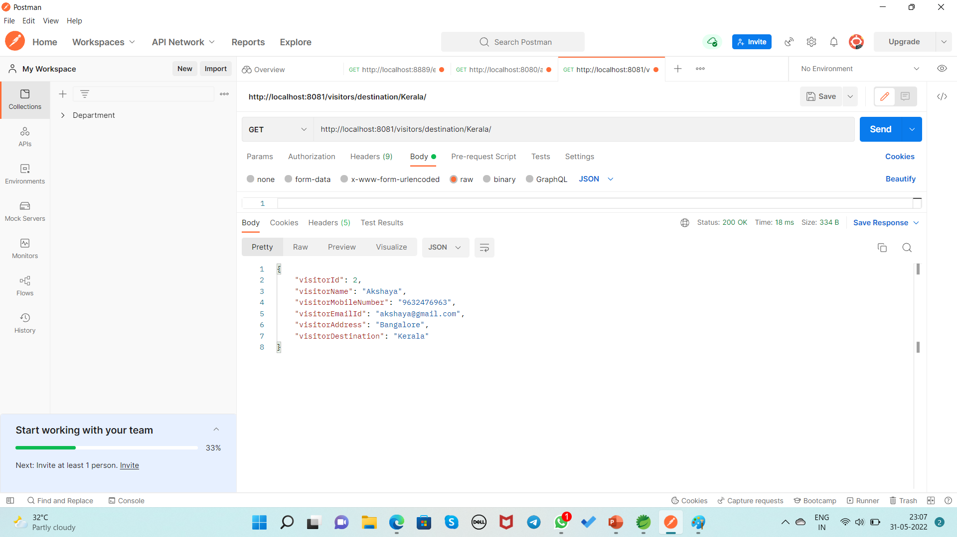
Display the record of Visitor based on Destination By Using GET Method URL:http://localhost:8081/visitors/destination/Kerala/

Slide 25
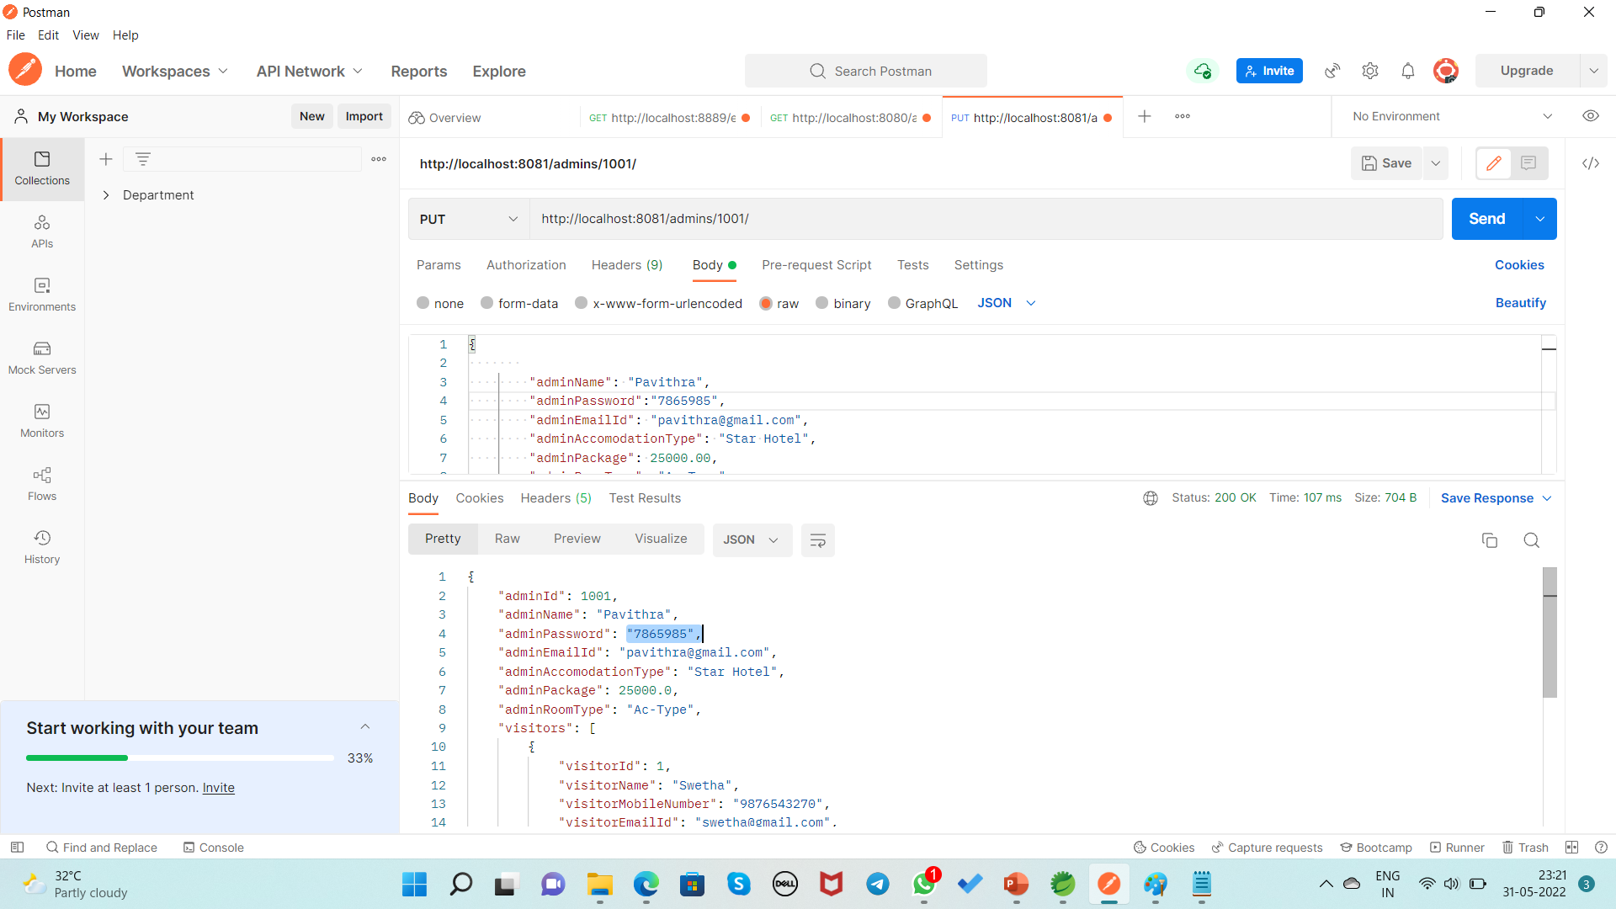
If Admin wants to change the Password By Using PUT Method URL:http://localhost:8081/admins/1001/

Slide 26
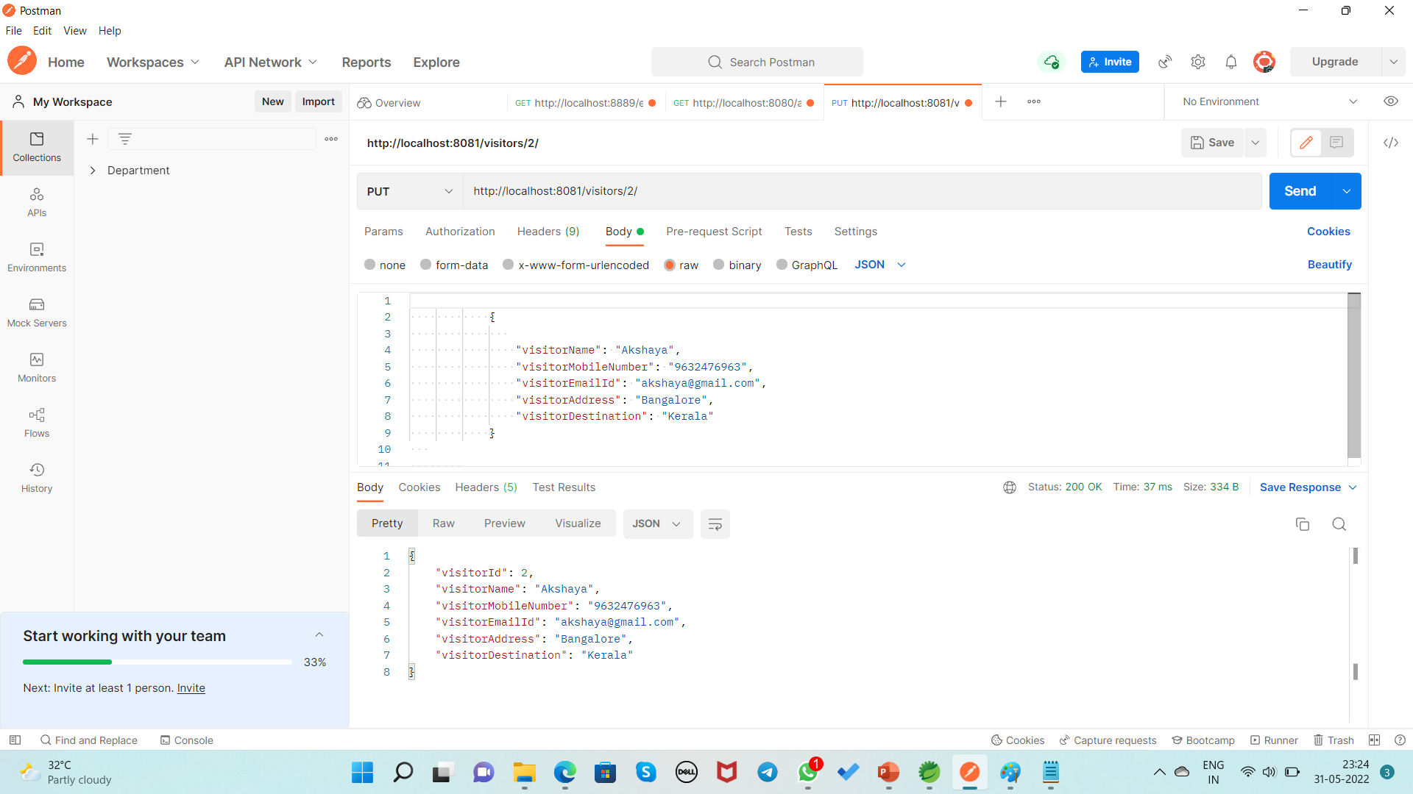
If Visitor wants to change the Address and Destination By Using PUT Method URL:http://localhost:8081/visitors/2/

Slide 27
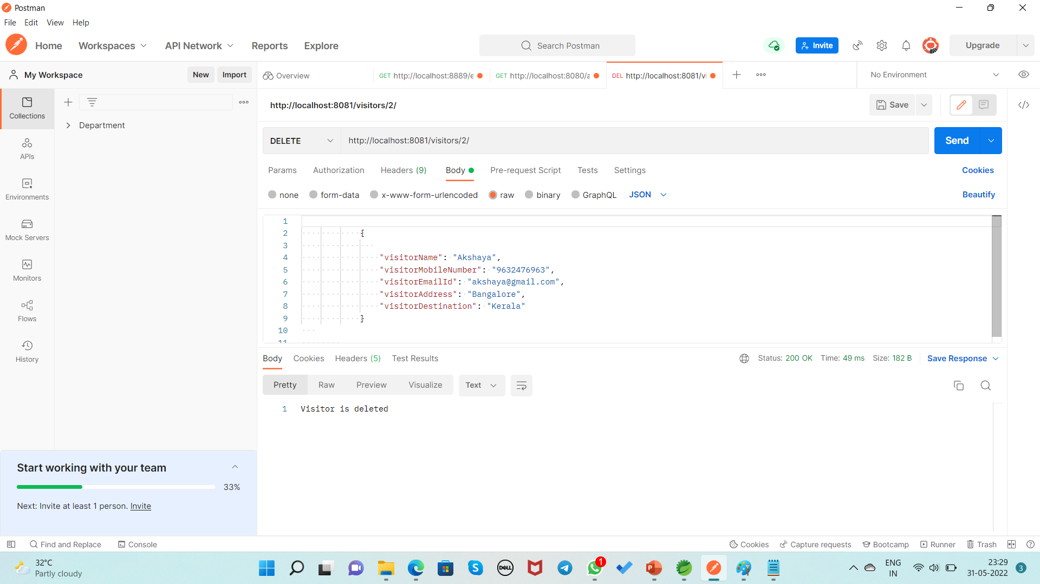
Deleting the Visitor Record Based on Id By Using DELETE Method URL:http://localhost:8081/visitors/2/

Slide 28
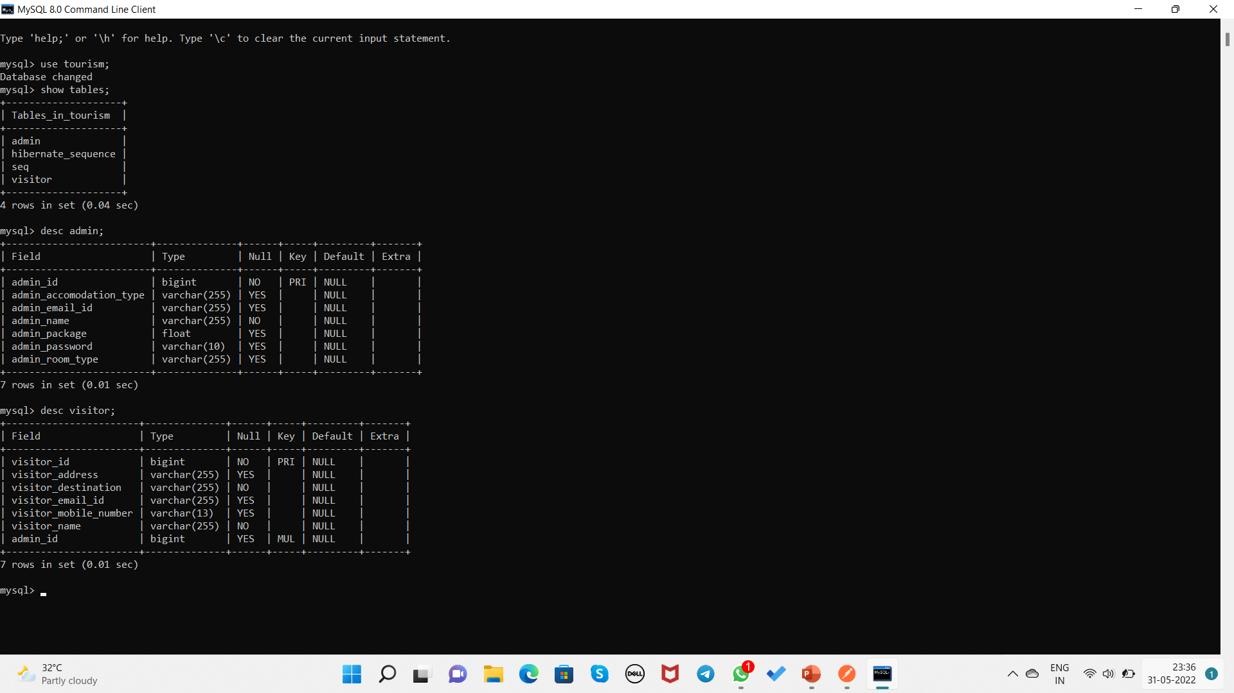
Database Table Design

Slide 29
Conclusion
Tourism Management System make visitors easy to choose tourist place and accommodation by giving affordable packages to them and easy place to find and sort visitor’s information.

Slide 30
THANK YOU…

